Slide 1
CSE 107: Object Oriented Programming Language
Dr. Tanzima Hashem
Professor
CSE, BUET

Slide 2
Inheritance
Inheritance allows one object to inherit member variables and/or member functions from another object
Inherited object is called base object
Inheriting object is called derived object
Helps programmer to write reusable code
Helps programmer to write compact code

Slide 3
Inheritance
Inheritance starts with defining the base class first
class base-class-name {
…….
};
Derived class is then defined using the base class
The general form of deriving a class from another class is as follows:
class derived-class-name: access base-class-name {
………
};
Access can be either private or public or protected
Default access is private for derived class, public for derived structure

Slide 4
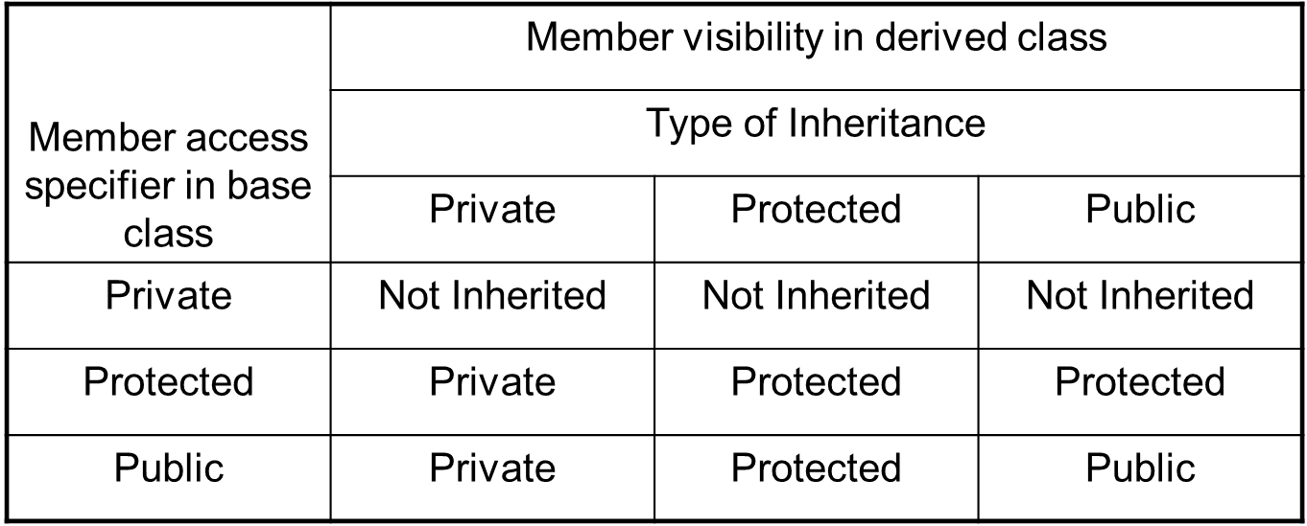
Visibility of base class members in derived class

Slide 5
Inheritance: Base Class
#include <iostream>
using namespace std;
class Rectangle {
int width, length;
public:
void set_width(int w) {width=w;}
void set_length(int l) {length=l;}
int area() {return (width*length);}
};

Slide 6
Inheritance: Derived Class
class Box: public Rectangle {
int height;
public:
void set_height (int h){height=h;}
int volume () {return (area()*height);}
/ *private members of the base class cannot be accessed by the derived class*/
//int volume () {return (width*length*height);}
};

Slide 7
Inheritance:
int main(){
Rectangle rect;
Box box;
rect.set_width(3);
rect.set_length(4);
box.set width(3); //inherited
box.set_length(4); //inherited
box.set_height(5);
cout<<“Rectangle area: ”<<rect.area()<<endl;
cout<< “Box base area: base area: ”<<box.area()<<endl; //inherited
cout<<“Box volume: ”<<box.volume()<<endl;
return 0;
}

Slide 8
Inheritance: Derived Class
class Box: private Rectangle {
int height;
public:
void set_height (int h){height=h;}
int volume () {return (area()*height);}
};

Slide 9
Inheritance
int main(){
Rectangle rect;
Box box;
rect.set_width(3);
rect.set_length(4);
//box.set width(3);
//box.set_length(4);
box.set_height(5);
cout<<“Rectangle area: ”<<rect.area()<<endl;
/* function area() is private to Box object cannot be accessed outside Box object */
//cout<< “Box base area: base area: ”<<box.area()<<endl;
cout<<“Box volume: ”<<box.volume()<<endl;
return 0;
}

Slide 10
Inheritance: Base Class
#include <iostream>
using namespace std;
class Rectangle {
protected:
int width, length;
public:
void set_width(int w) {width=w;}
void set_length(int l) {length=l;}
int area() {return (width*length);}
};

Slide 11
Inheritance: Derived Class
class Box: public Rectangle {
int height;
public:
void set_height (int h){height=h;}
/*protected members of the base class can be accessed by the derived class */
int volume () {return (width*length*height);}
};

Slide 12
Inheritance
int main(){
Rectangle rect;
Box box;
rect.set_width(3);
rect.set_length(4);
box.set width(3); //inherited
box.set_length(4); //inherited
box.set_height(5);
cout<<“Rectangle area: ”<<rect.area()<<endl;
cout<< “Box base area: ”<<box.area()<<endl; //inherited
cout<<“Box volume: ”<<box.volume()<<endl;
return 0;
}

Slide 13
Constructors, Destructors, and Inheritance
Both base class and derived class can have constructors and destructors
Constructor functions are executed in the order of derivation
Destructor functions are executed in the reverse order of derivation
While working with an object of a derived class, the base class constructor and destructor are always executed no matter how the inheritance was done (private, protected or public)

Slide 14
Constructors, Destructors, and Inheritance
class base {
public:
base() {
cout << “Constructing base class\n”;
}
~base() {
cout << “Destructing base class\n”;
}
};
class derived : public base {
public:
derived() {
cout << “Constructing derived class\n”;
}
~derived() {
cout << “Destructing derived class\n”;
}
};
void main() {
derived obj;
}
Output:
Constructing base class
Constructing derived class
Destructing derived class
Destructing base class

Slide 15
Constructors, Destructors, and Inheritance
If a base class constructor takes parameters then it is the responsibility of the derived class constructor(s) to collect them and pass them to the base class constructor using the following syntax -
derived-constructor(arg-list) : base(arg-list) { … }
Here “base” is the name of the base class
It is permissible for both the derived class and the base class to use the same argument
It is also possible for the derived class to ignore all arguments and just pass them along o the base class.

Slide 16
Constructors, Destructors, and Inheritance
class MyBase {
public:
int x;
MyBase(int m) { x = m; }
};
class MyDerived : public MyBase {
public:
int y;
MyDerived() : MyBase(0) { y = 0; }
MyDerived(int a) : MyBase(a)
{
y = 0;
}
MyDerived(int a, int b) : MyBase(a)
{
y = b;
}
};
void main() {
MyDerived o1; // x = 0, y = 0
MyDerived o2(5); // x = 5, y = 0
MyDerived o3(6, 7); // x = 6, y = 7
}

Slide 17
The End
Acknowledgement
http://faizulbari.buet.ac.bd/Courses.html
http://mhkabir.buet.ac.bd/cse201/index.html
Topic Covered: Chapter 7

